Slide 1


Classification of Depression Patients Using 128-Channel Resting-State EEG
A revolutionary approach leveraging machine learning for accurate mental health diagnostics, offering new hope for those affected by depression.
by SANDEEP VERMA

Slide 2

Addressing the Global Crisis of Depression
Depression is a widespread affliction impacting millions worldwide. Timely and precise diagnosis is paramount.
300M
50%
Massive Impact
Alarming Misdiagnosis Rates
Globally, over 300 million individuals across all age groups are grappling with depression.
Nearly 50% of depression cases face the challenge of misdiagnosis or remain undetected.
80%
Critical Lack of Access
In numerous areas, more than 80% of those affected lack access to essential treatment and support.

Slide 3


Slide 4
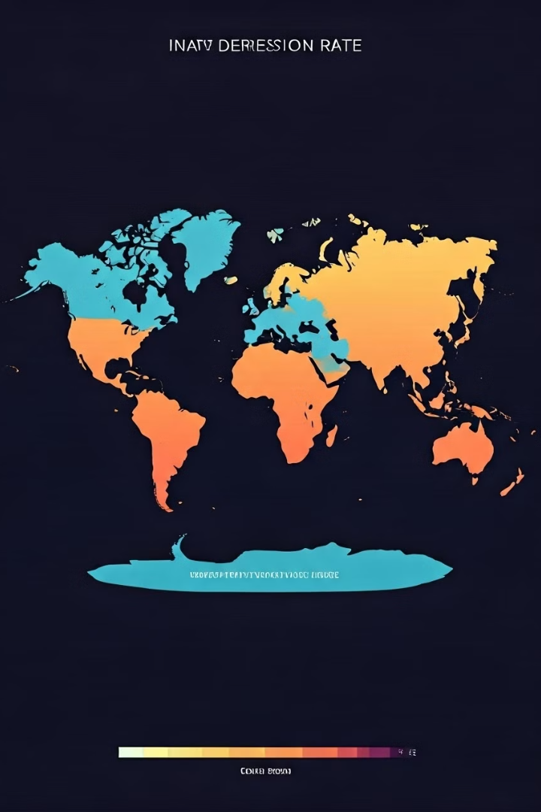
The Global Depression Challenge
Global Impact
Public Health Crisis
300+ million people affected.
MDD as a critical issue.
Diagnostic Needs
Objective, precise methods needed.
Traditional methods often fall short due to their subjective nature, underscoring the need for innovative diagnostic tools.

Slide 5




EEG Technology: A Neurological Window
High-Resolution Brain Mapping
Subtle Variations
Real-Time Analysis
Captures neurophysiological nuances.
128-channel system.
Non-invasive monitoring.
EEG technology offers superior temporal resolution compared to other imaging techniques, allowing for real-time brain signal analysis.

Slide 6




Machine Learning Approach
CNN Algorithm
Primary classification.
LSTM Integration
Sequence learning.
Feature Extraction
Multiple brain bands.
The machine learning approach leverages a CNN for classification and LSTM for sequence learning, extracting features from multiple brain frequency bands.

Slide 7
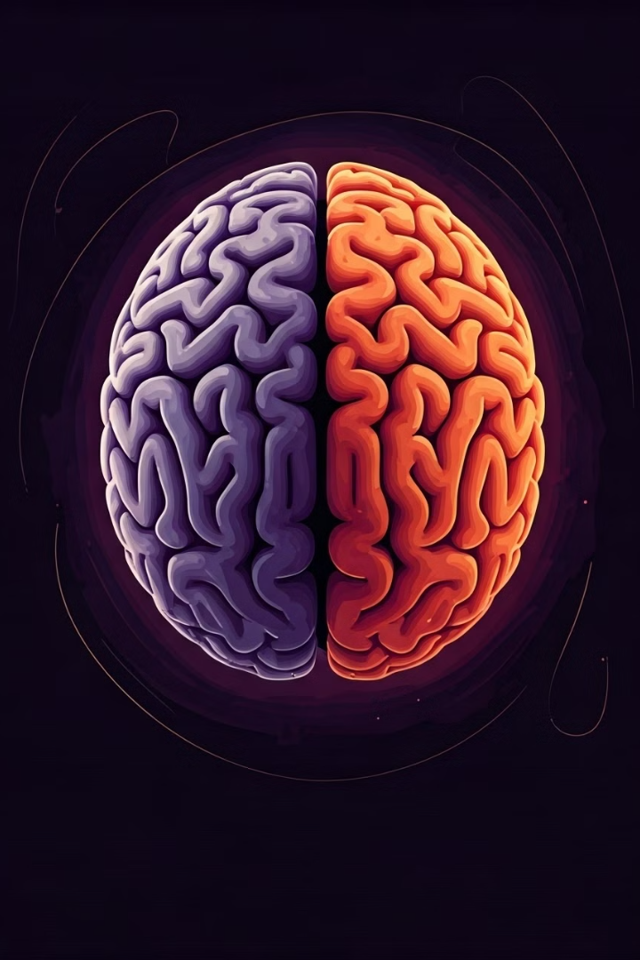
Key Neurological Indicators
Hemispheric Asymmetry
Alpha Rhythm
Variations analyzed.
Left vs. Right brain.
Connectivity Analysis
Functional patterns.
Identifiable neurological indicators include asymmetry between brain hemispheres, alpha rhythm variations, and functional connectivity analysis.

Slide 8



Classification Methodology
EEG Collection
Resting-state signals.
Bandpass Filtering
Noise reduction.
Model Training
Machine learning.
The methodology involves resting-state EEG signal collection, bandpass filtering for noise reduction, feature extraction, and machine learning model training.

Slide 9
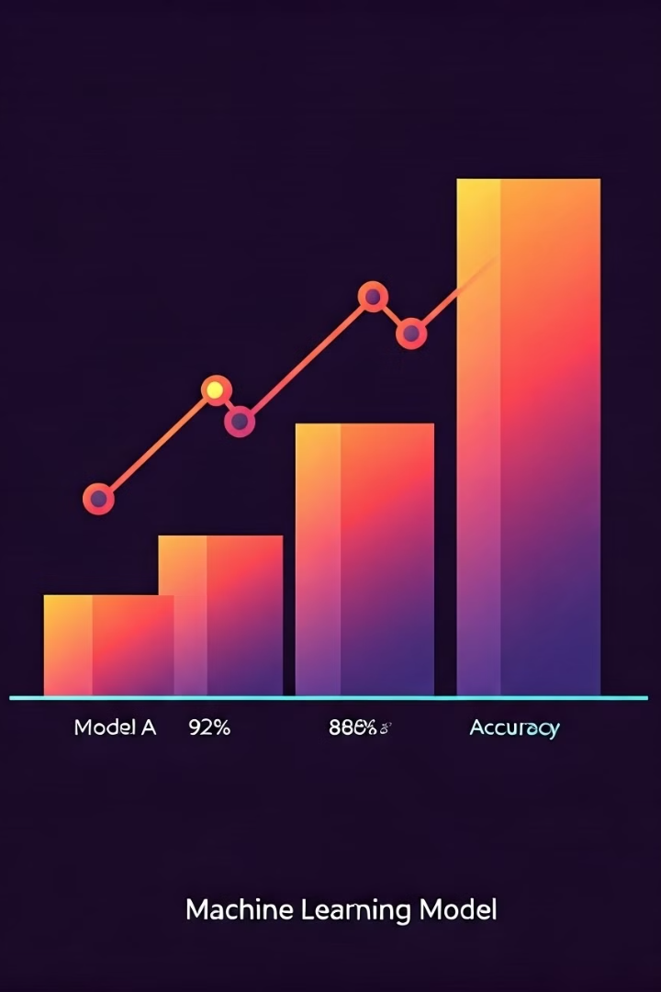
Performance Metrics
97%
99.12%
Overall Accuracy
Right Hemisphere
Using 128-channel system.
Signal accuracy.
97.66%
Left Hemisphere
Signal accuracy.
The system achieves 97% classification accuracy with the 128-channel system, with particularly high accuracy in right hemisphere signals.

Slide 10
Clinical Implications
Early Detection
Personalized Treatment
Objective Support
Potential for early intervention.
Tailored approaches.
For clinicians.
The technology offers the potential for early depression detection, personalized treatment planning, and objective diagnostic support for clinicians.

Slide 11



Future Research Directions
Integrate Markers
2
Physiological data.
Expand Diagnostics
1
Enhance capabilities.
Sophisticated Models
3
Neural networks.
Future research will focus on expanding diagnostic capabilities, integrating additional physiological markers, and developing more sophisticated neural network models.

Slide 12

Conclusion
Revolutionary Approach
Transforms Detection
Hope for Millions
To mental health diagnostics.
Machine learning.
Suffering with mental health issues.
This machine learning approach transforms depression detection and offers a promising pathway to precision psychiatry, providing hope for millions.

